Slide 1
Service Catalog Design
Bernice Templeman

Slide 2
Service Request Management system provides an intuitive interface with predefined work flows for IT requests to be reliably submitted, routed, approved, monitored and delivered with minimum human interference.

Slide 3
Project Overview
Develop a complex Service Catalog using a Custom Table, including Catalog Clients scripts/Catalog UI policies, and complex Workflows.
Composite service request
Minimum one custom table
Minimum four tasks created by workflow
Notifications
Form design should have between 10 and 15 variables at minimum
Set different stages / set different state of the RITM

Slide 4
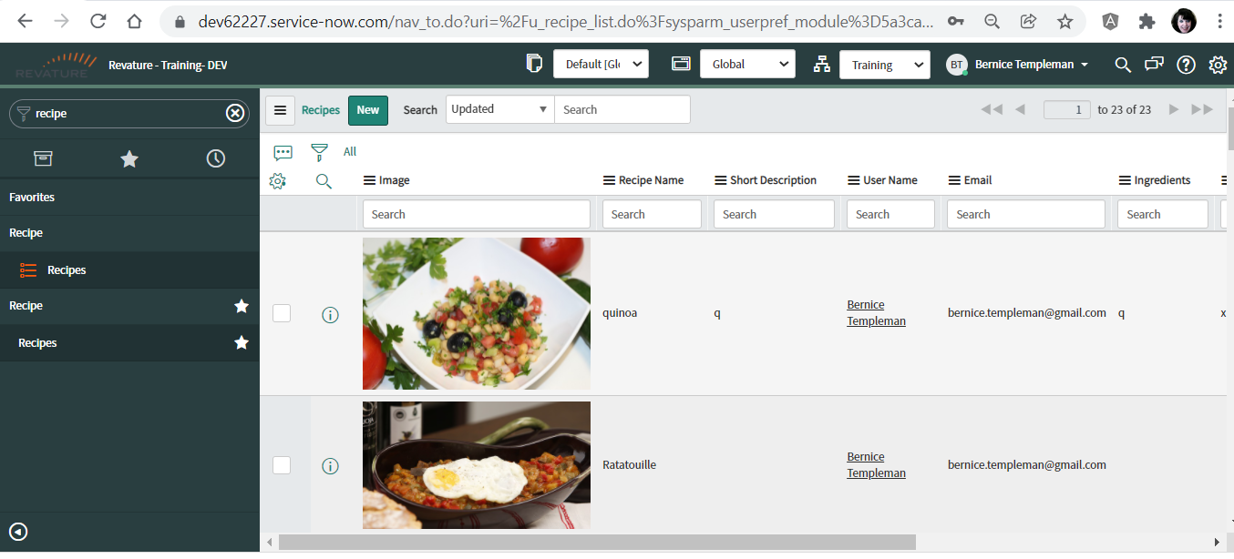
Custom Table

Slide 5
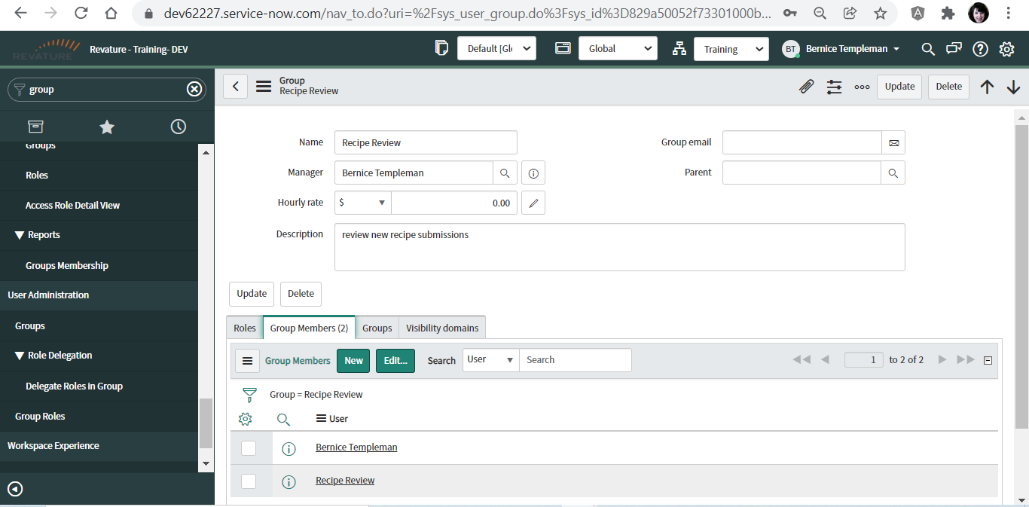
Group for team members

Slide 6
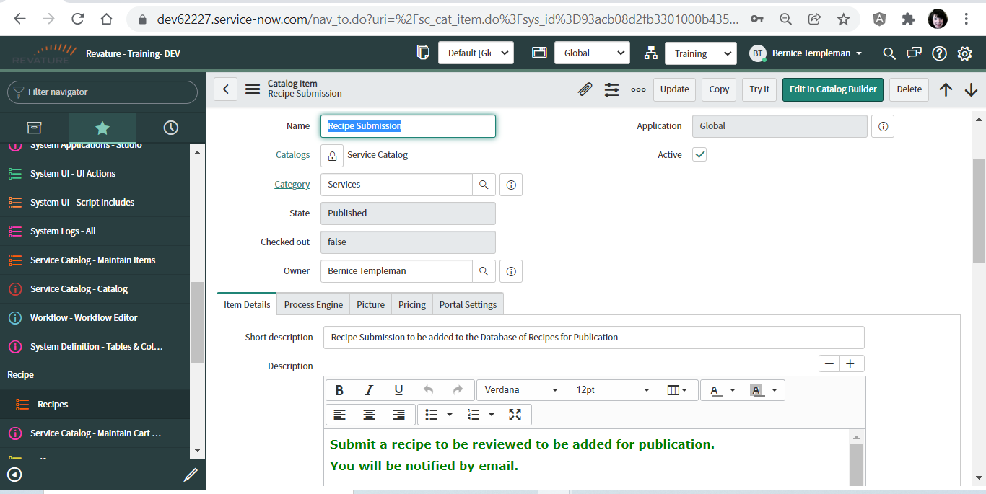
New Catalog Form

Slide 7
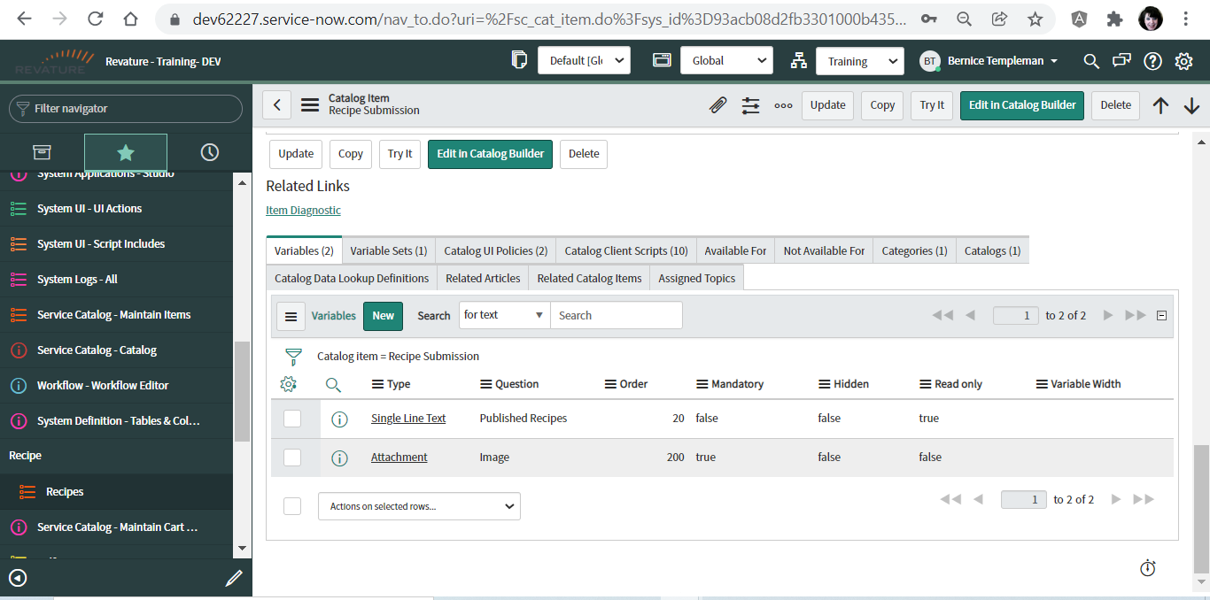
Variables

Slide 8
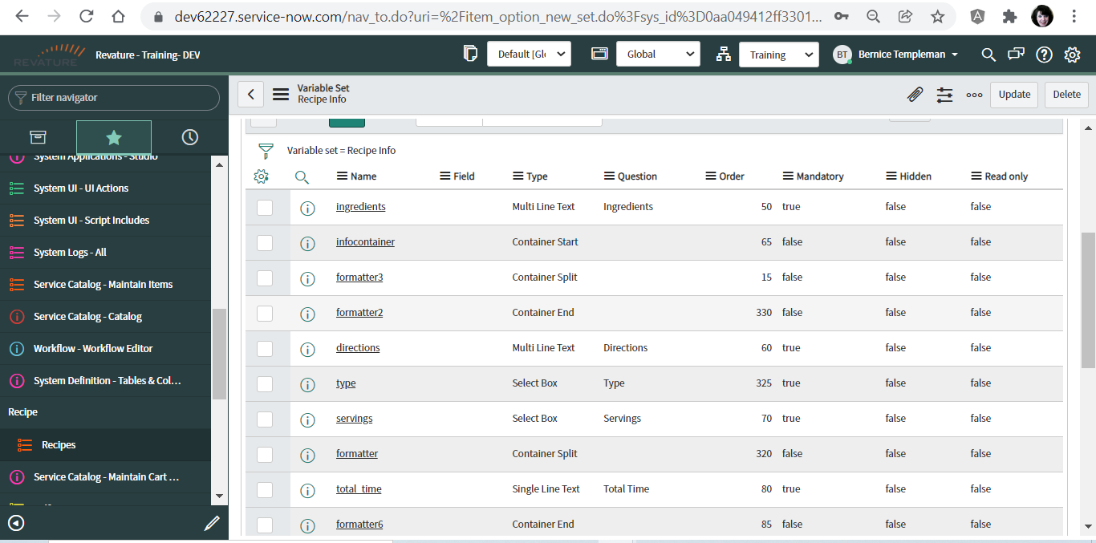
Variable Set

Slide 9

Catalog UI Policies

Slide 10
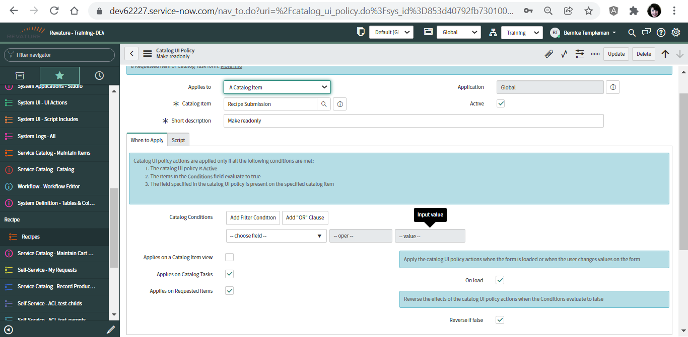

Slide 11
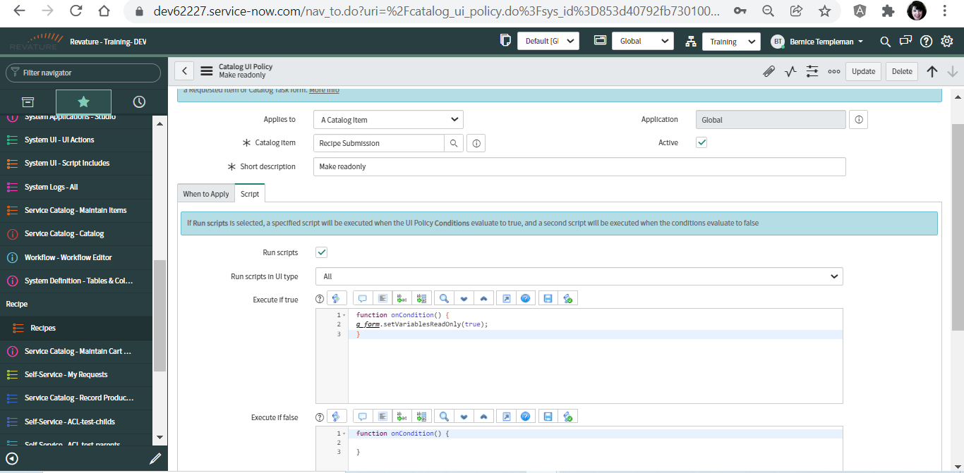

Slide 12
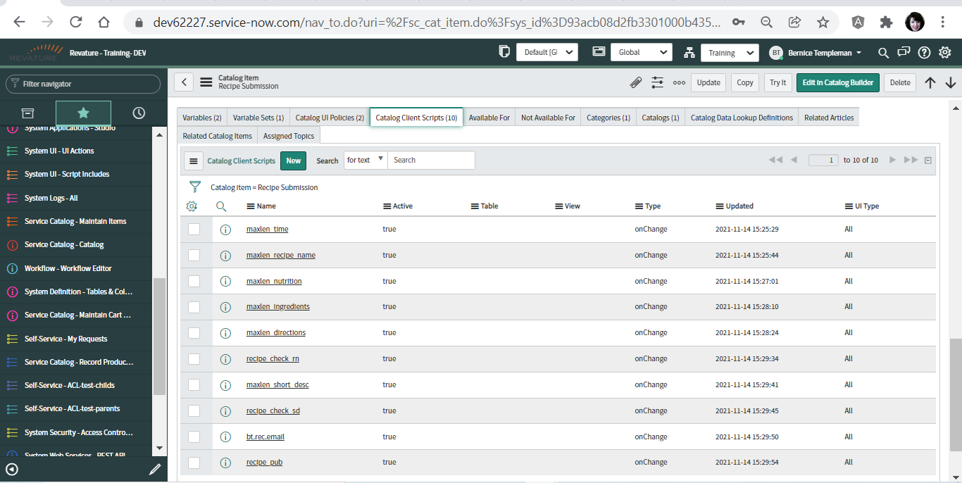
Catalog Client Scripts

Slide 13
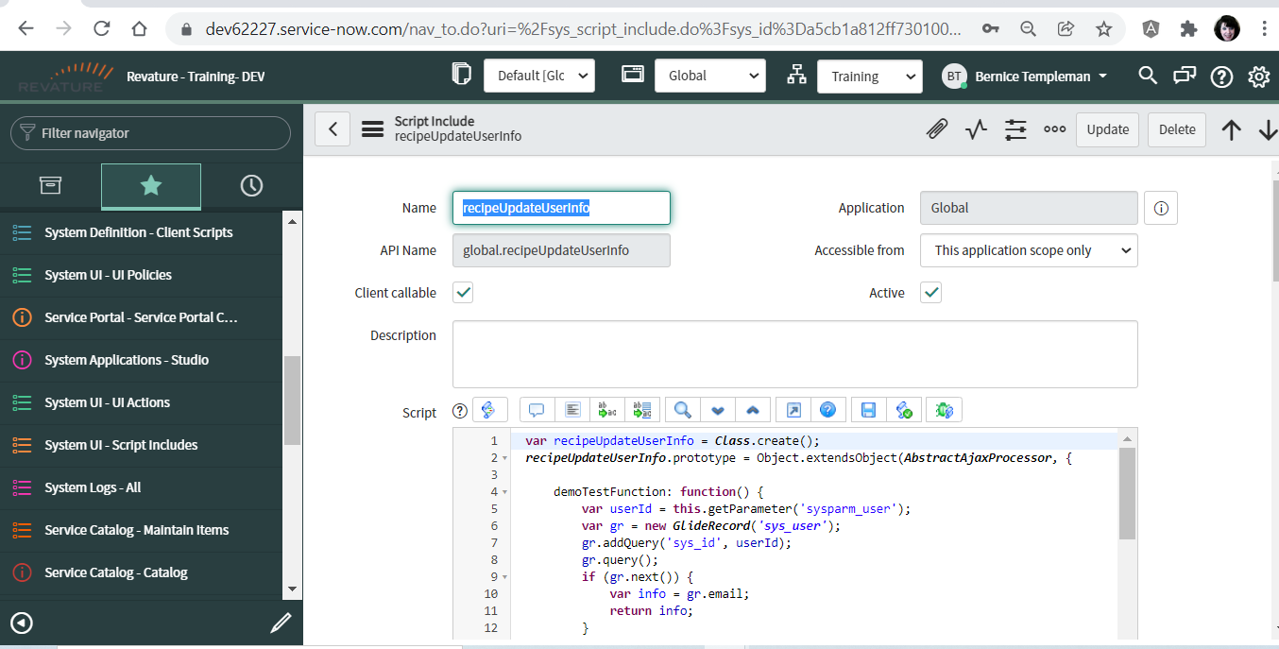
Script Include

Slide 14
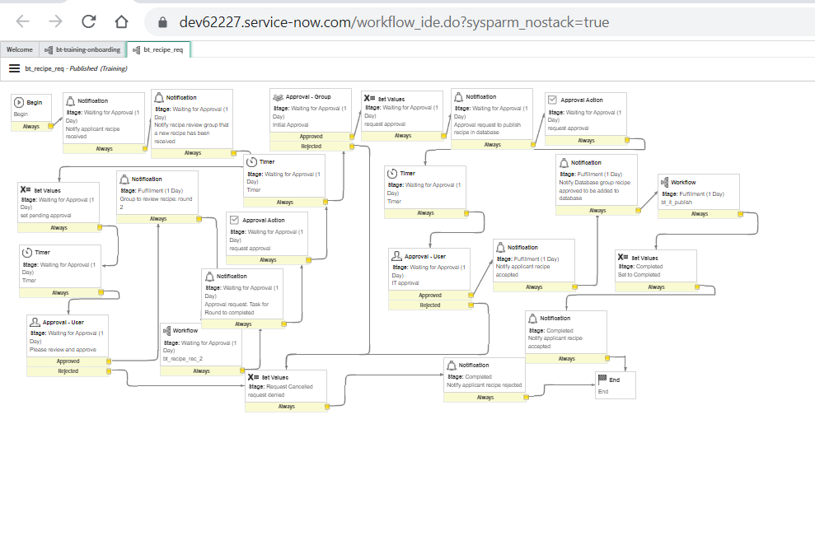
Workflow

Slide 15
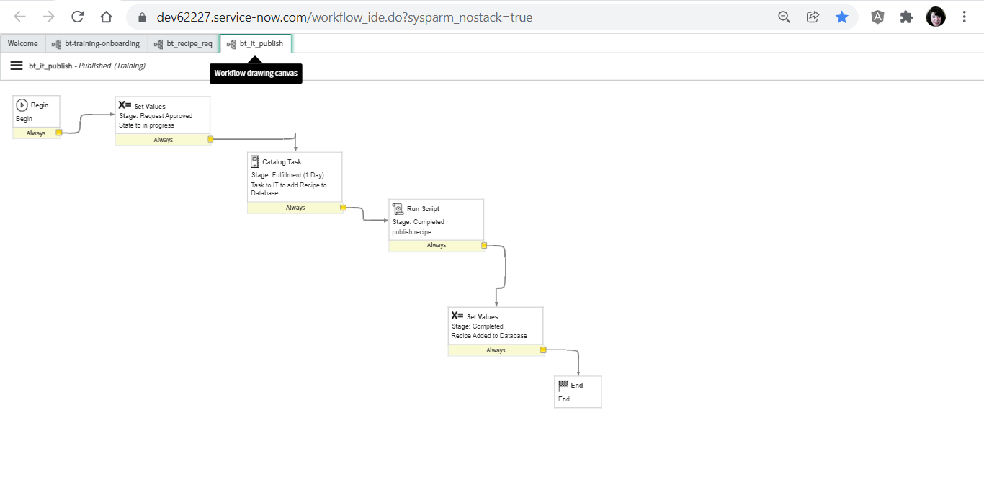

Slide 16
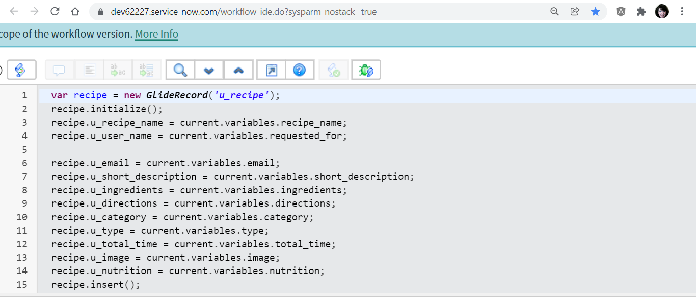
Script

Slide 17
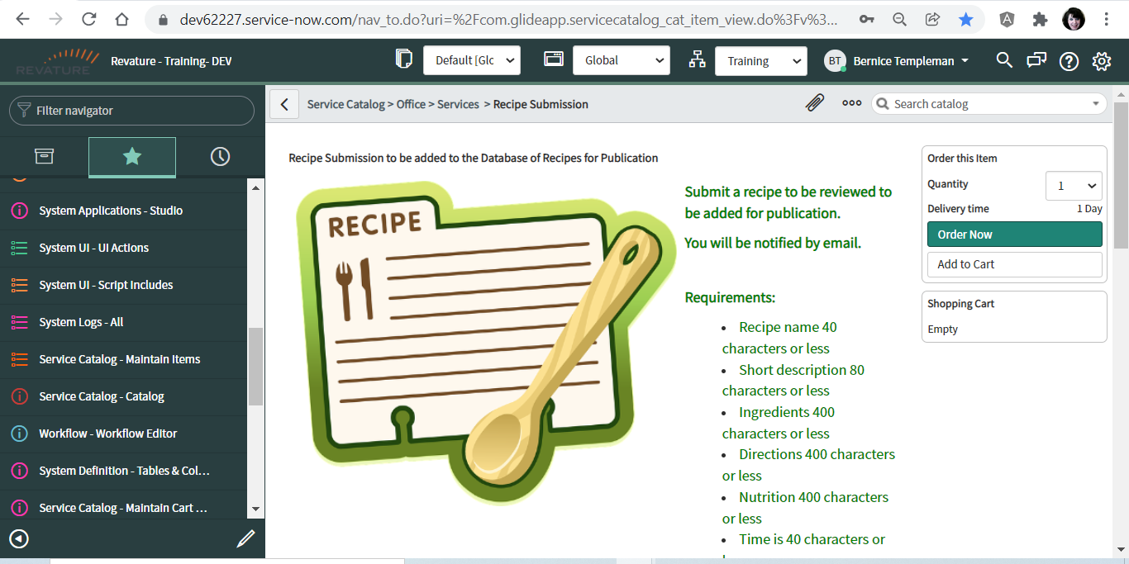
Catalog

Slide 18
Thank You.

